Slide 1
Transmission of motion and power

Slide 2
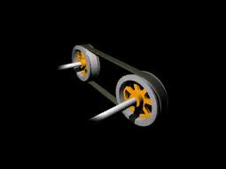
Power Transmission:-
Power transmission is a process to transmit motion from one shaft to another shaft

Slide 3
Power Transmission System OR Mechanical Drive
It is the intermediate mechanism which transmit power or motion from the prime mover to machine
To connect the shaft ,mainly two types of connectors are used ,
Flexible
Rigid

Slide 4
Individual Drive
When a prime mover is used to drive a single machine then the system of power transmission is called as individual drive system

Slide 5
Group Drive:-
Motor
main shaft
counter shaft
Machine
Machine
Machine
Belt

Slide 6
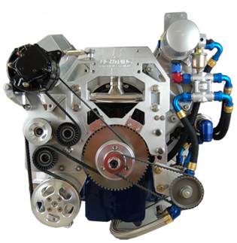
Flexible Drive:-
Belt Drive:-
Belts are used to transmit power between two parallel shafts by means of friction using pulleys.

Slide 7
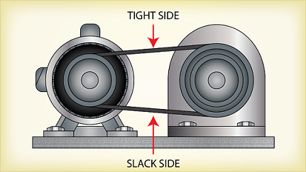
Open Belt Drive:-

Slide 8
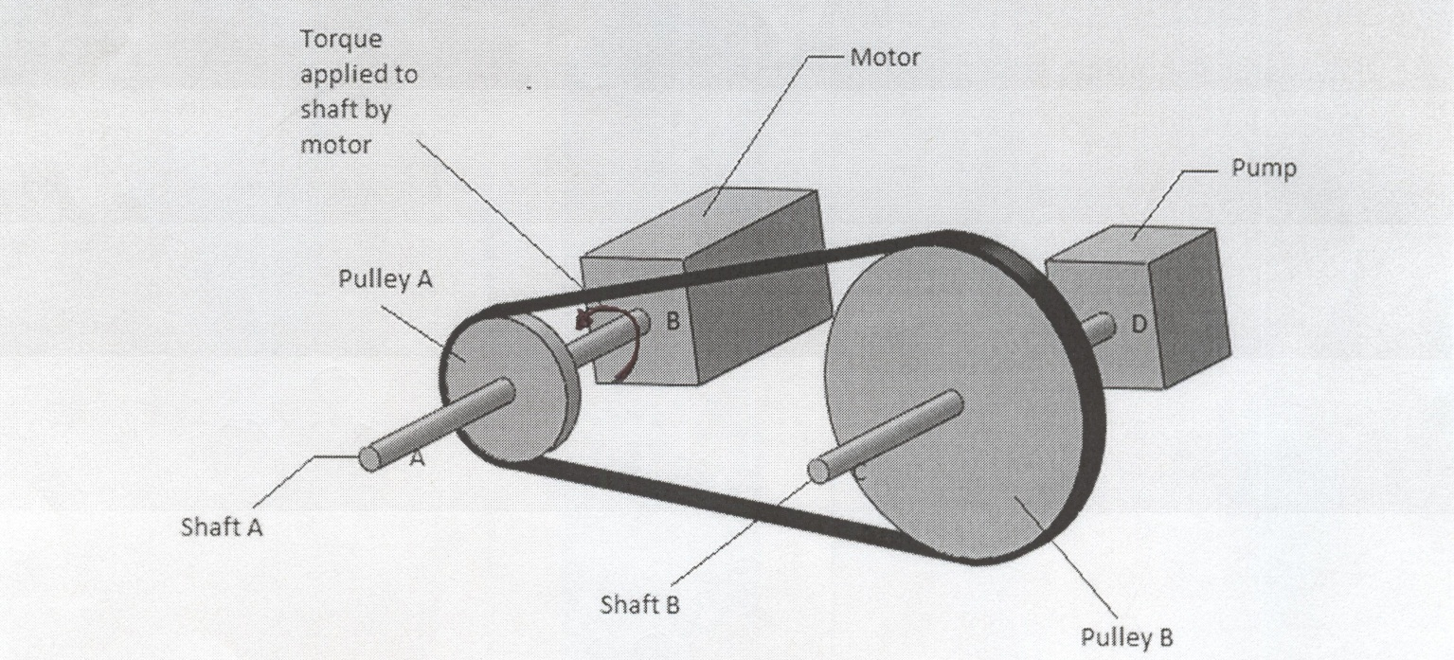
Open Belt Drive:-
The driver and driven shaft both rotate in the same
direction in open belt drive.

Slide 9
Crossed belt drive:
When shafts are parallel but need to be rotated in the opposite directions, crossed belt drive is used.

Slide 10
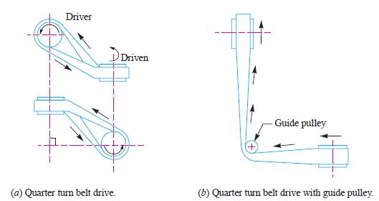
Quarter Twist Drive:-
Also known as right angle belt drive,
It is used to transmit power between two shafts at right angle
Larger face width pulley should be used to prevent the belt from leaving the pulley

